Slide 1

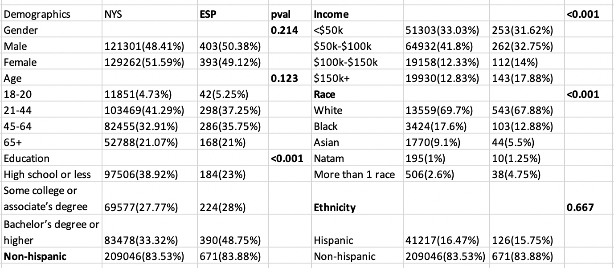
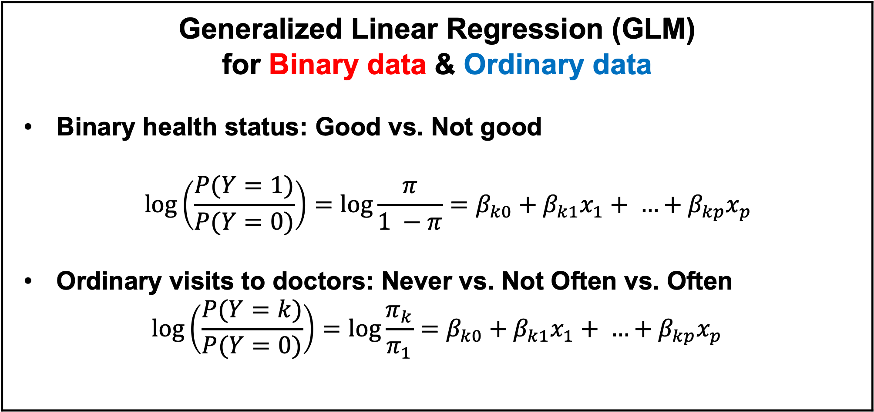
Empire State Poll 2019 Data Analysis
Tianran Zhang, Haojia Li, Zihan Yang
Faculty Advisor & Client: Dr. Jessica Ancker
ABSTRAT
METHOD
Visits to doctors ESP There are more males never go to visit a doctor than females, thus we stratify the data by gender.
Poor numeracy (skill with numbers and math) is likely to affect health because it may interfere with peoples’ ability to understand their health data, understand instructions from their doctors, etc. We explored the people’s numeracy score and some demographical factors related to a binary self-reported health outcome of good health or not on both Empire Stall Poll (ESP) dataset and PIAAC dataset.
Generalized Linear Regression (GLM) for Binary data & Ordinary data Binary health status: Good vs. Not good $$\log\left(\frac{P(Y=1)}{P(Y=0)}\right)=log\frac{π}{1 −π}{=β_{k0}+β_{k1}x_{1}+ …+β_{kp}x_{p}}$$ Ordinary visits to doctors: Never vs. Not Often vs. Often $$\log\left(\frac{P(Y=k)}{P(Y=0)}\right)=log\frac{π_{k}}{π_{1}}{=β_{k0}+β_{k1}x_{1}+ …+β_{kp}x_{p}}$$
 |  | Visits to doctors: Never vs. Not Often vs. Often
Response | Outcome | Male |  | Female
Weights | Adjusted Covariates | / | Education; Income | /
Performance | Prediction Error Rate | 0.4395 | 0.4599 | 0.2819
Predictor | Numeracy
Covariates | Age
 | Education | * | *
 | Income | * | *
 | Race
 | Hispanic |  |  | *
Introduction
People’s self-reported health status Numeracy score and education is significant different between people with good vs. not good health status (t-test p-value < 0.05). We will mainly focus on the relationship between these two variables and people’s self reported health status. Visits to doctors There is some association between people’s health status and visits to doctors. Most people go to doctors once every few months had good health. We divide visits to doctors into Never vs. Not often vs. Often in consideration of clinical meaning as well as data balancing. NYS data Compare the demographical proportions of our ESP data with NYS data, Fisher’s test show that education, income and race are significantly different in the two datasets. So, weighted regressions are considered for the further investigation.
RESULT
Self-report health status ESP PIAAC
CONCLUSION
Response | Outcome | Health status: Good vs. Not Good
Weights | Adjusted Covariates | / | Education; Income
Performance | AUC | 0.724 | 0.720
 | Power | 0.81 | 0.574
 | Prediction Error Rate | 0.219 | 0.219
Predictor | Numeracy | * | *
Covariates | Gender
 | Age | * | *
 | Education | * | *
 | Income | * | *
 | Race
 | Hispanic |  | *
Self-report health status The ESP result shows that Numeracy is a significant predictor in both weighted and unweighted regressions. Age, education, and income level are significant covariates of binary self-reported health status. The PIAAC result shows that numeracy is a significant predictor, while education and income levels are significant covariates. Besides, problem-solving is an additional significant predictor for numeracy. Visits to doctors ESP regression result shows that for males, education and income level are significant covariates of visits to doctors. While for females, Hispanic is a significant covariate. In summary, Our ESP regression has overperformed PIAAC regression with a lower prediction error rate in predicting people’s health status in NYS. We also provided an understanding of the association between some demographical factors and visits to doctors for medical analysts.
Response | Outcome | Health status: Good vs. Not Good
Performance | AUC | 0.676 | 0.69
 | Power | 0.75 | 0.77
 | Prediction Error Rate | 0.1475 | 0.1475
Predictor | Numeracy | * | *
Additional Predictors | Problem solving | / | *
 | Literacy | /
Covariates | Education | * | *
 | Income | * | *
 | Race
 | Hispanic
BIBLIOGRAPHY
Reference: Fagerlin, A., Zikmund-Fisher, B. J., Ubel, P. A., Jankovic, A., Derry, H. A., & Smith, D. M. (2007). Measuring numeracy without a math test: development of the Subjective Numeracy Scale. Medical Decision Making, 27(5), 672-680. Wu, M. (2005). The role of plausible values in large-scale surveys. Studies in Educational Evaluation, 31(2-3), 114-128. https://cran.r-project.org/web/packages/intsvy/intsvy.pdf https://nces.ed.gov/training/datauser/PIAAC_04/assets/PIAAC_04.pdf https://www.oecd.org/skills/piaac/piactools_16oct_for_web.pdf

